Slide 1

Group 7 Library Application
Hoang tin Nguyen – 618682
Osama Quttriyeh – 617575
Jeffrey metz - 111435

Slide 2
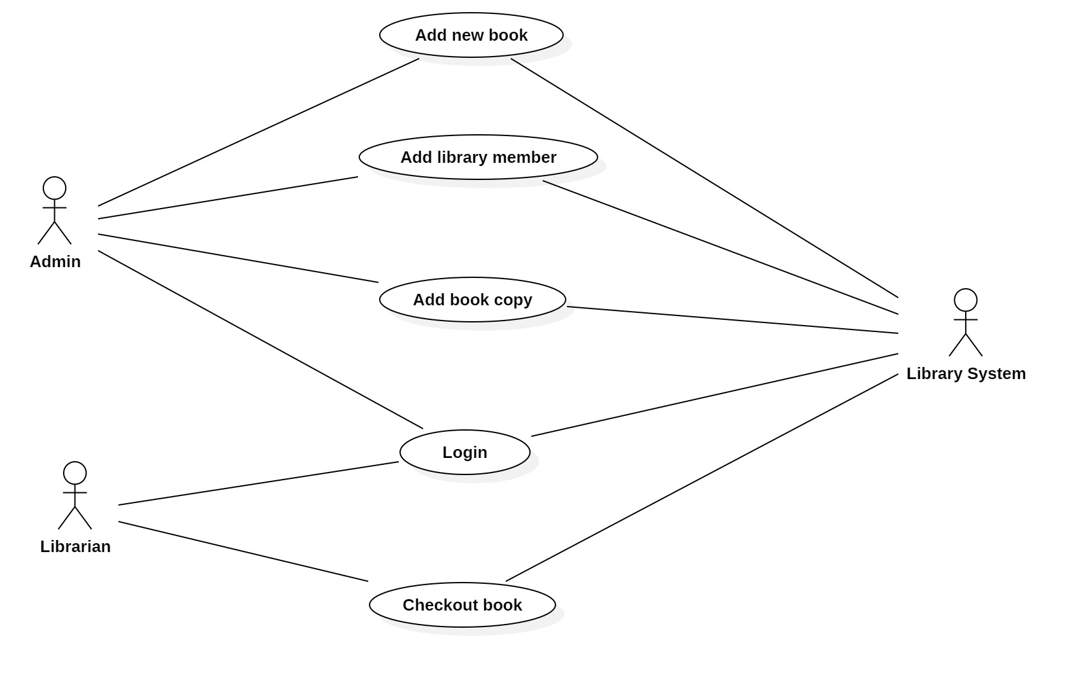
Use case diagram

Slide 3
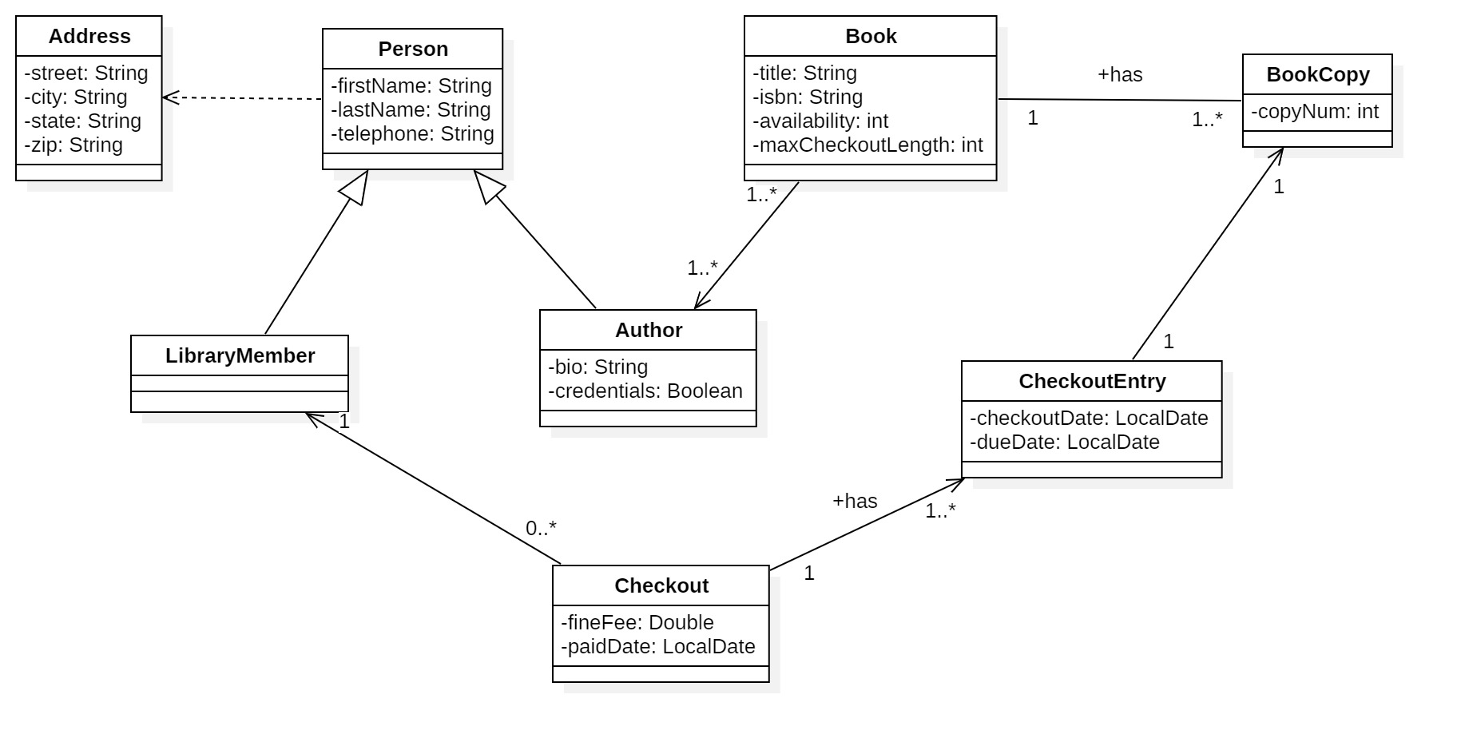
Class diagram

Slide 4
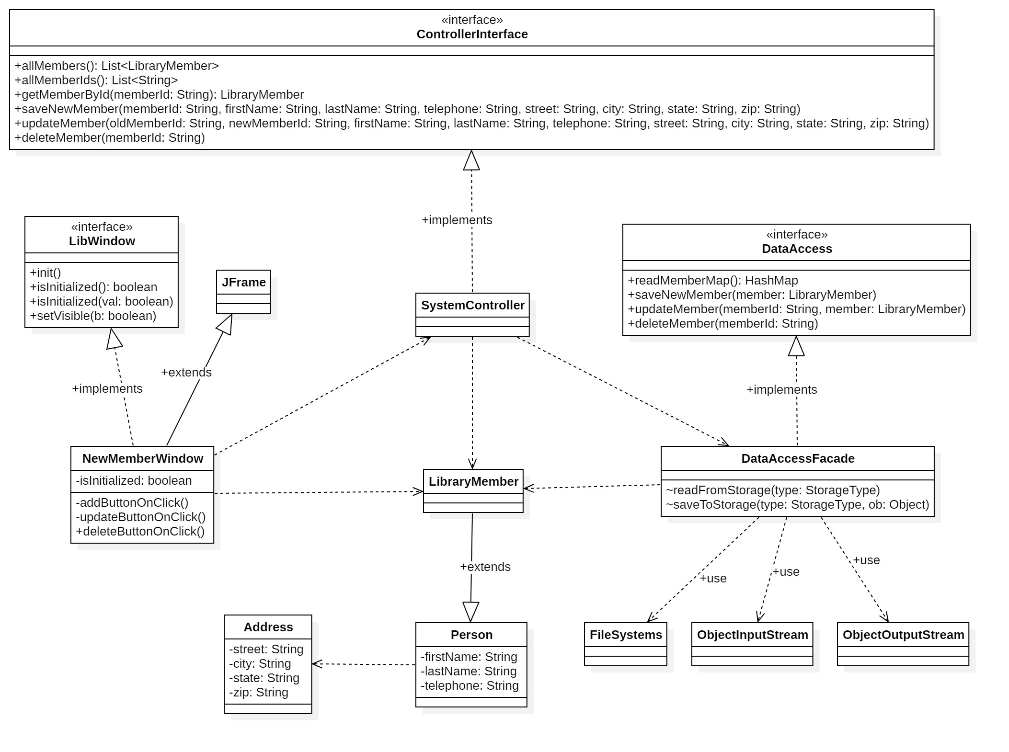
Class diagram – New member

Slide 5
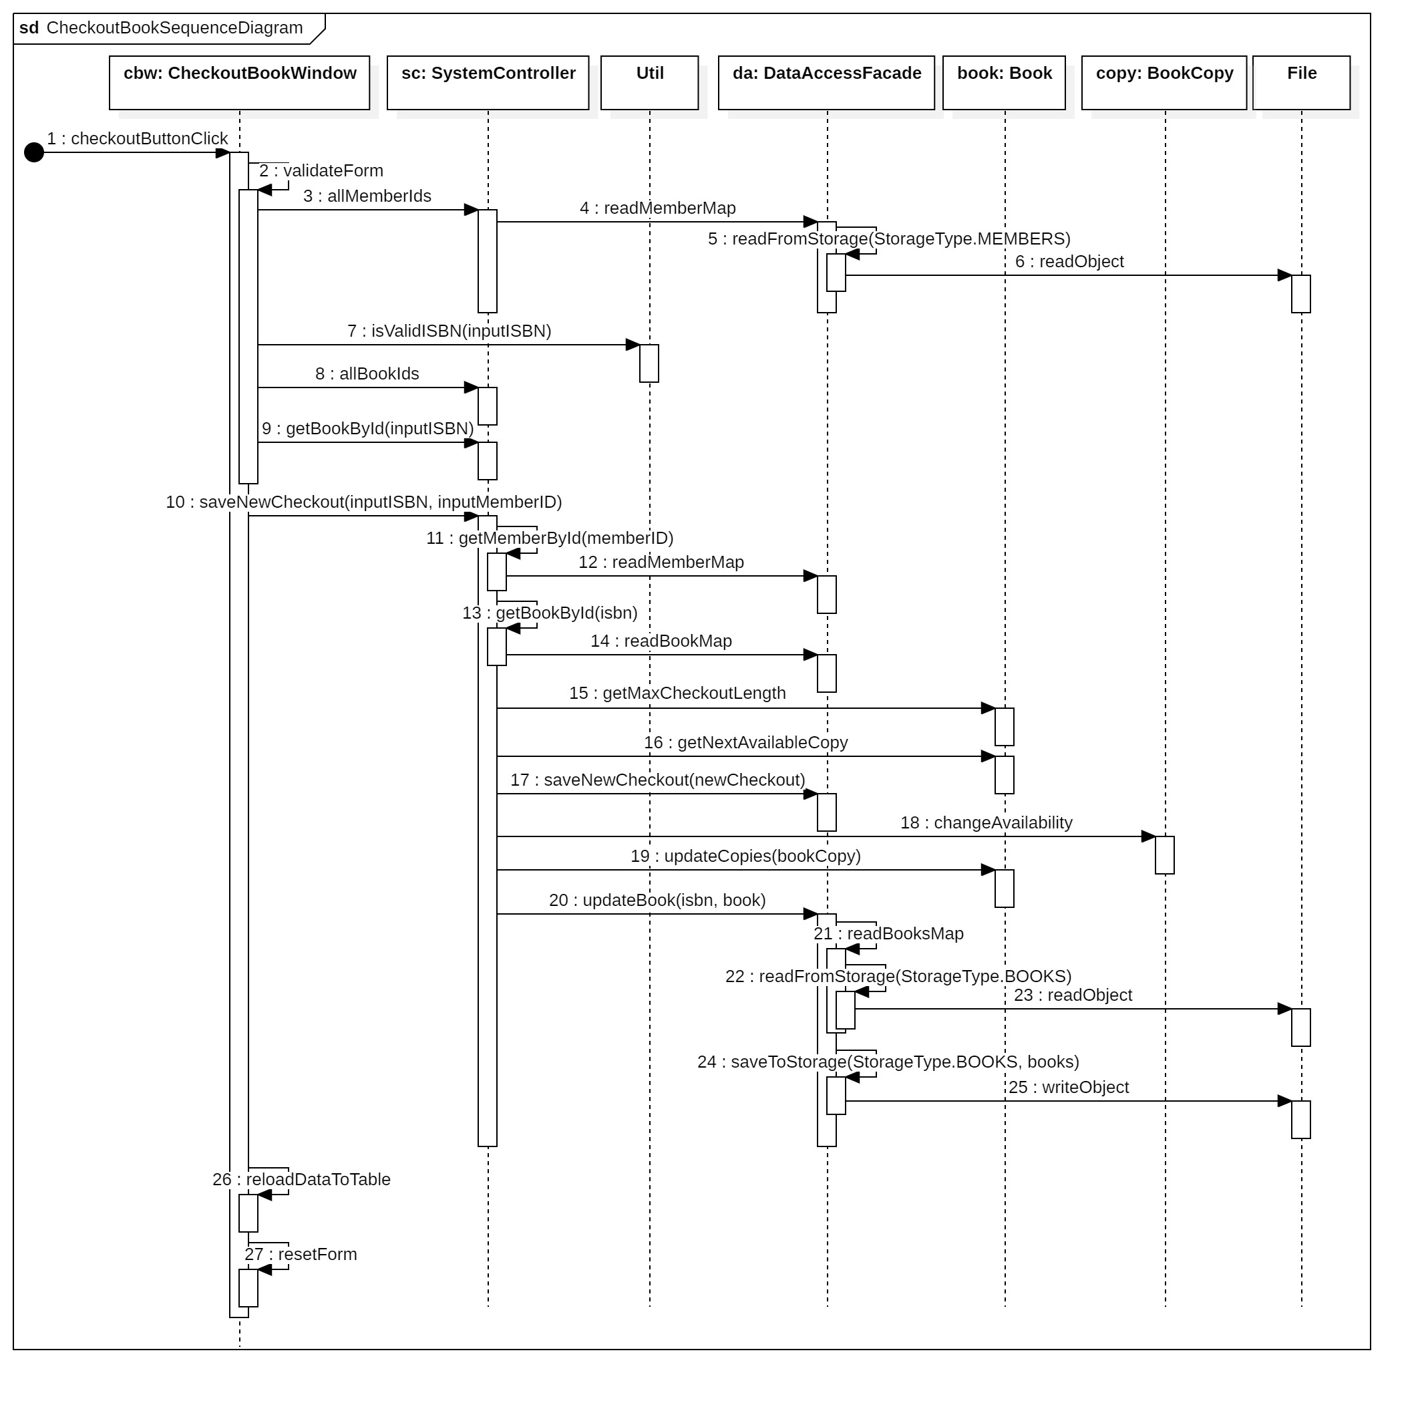
Sequence diagram 1 – Checkout book

Slide 6
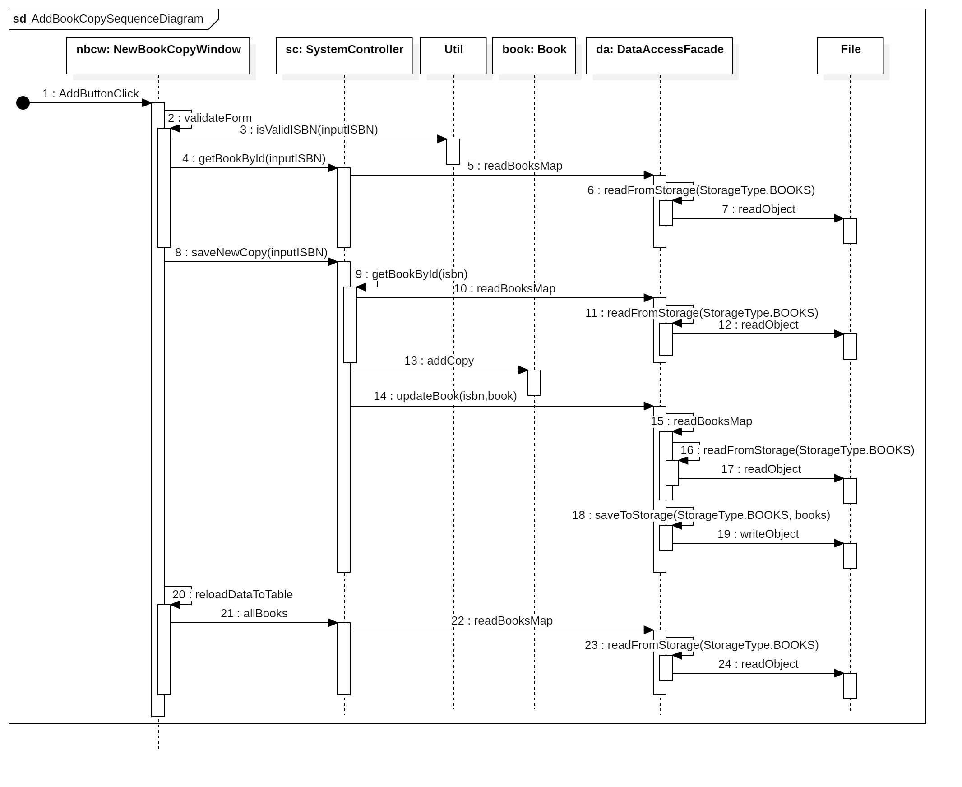
Sequence diagram 2 – Add book copy

Slide 7
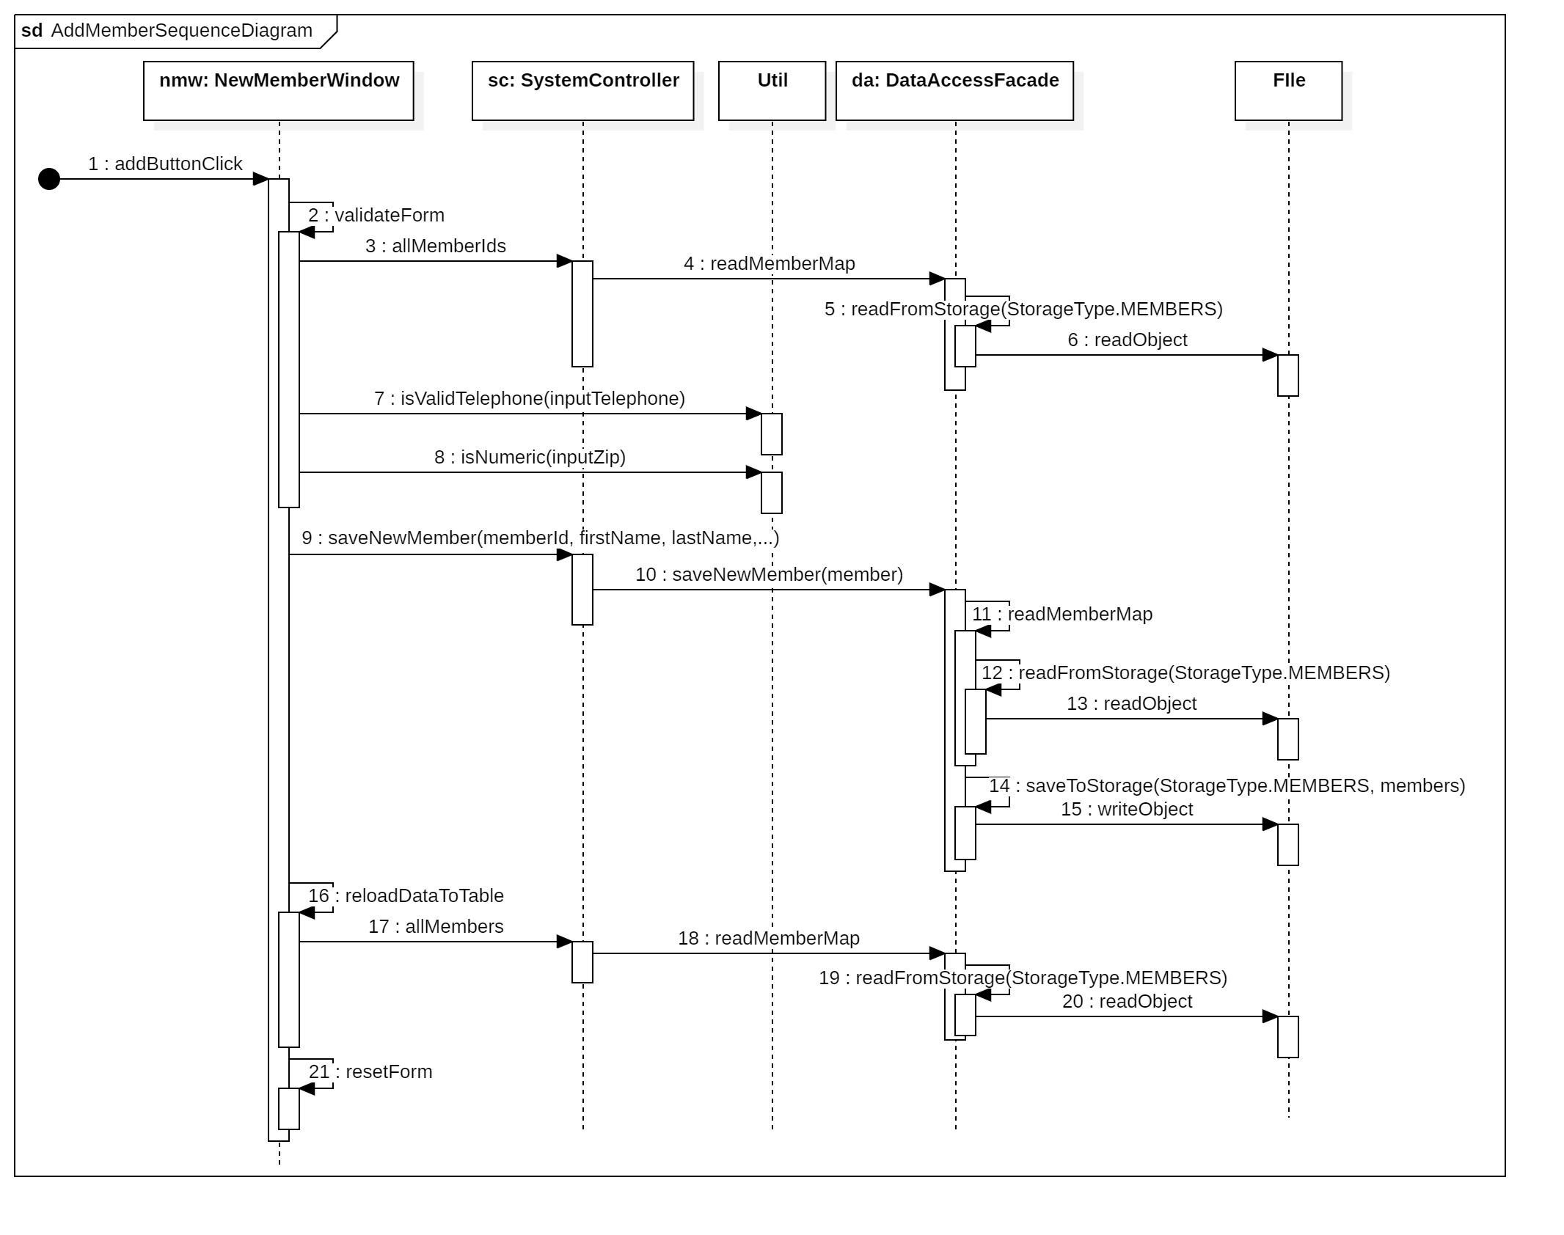
Sequence diagram 3 – Add member

Slide 8
Validation rules – Login form
Username and Password are required
Username must be existed
Password must be correct

Slide 9
Validation rules – New book form
Book title is required
Book isbn is required and valid “\d{2}-\d{5}”
Book isbn must be existed
Max checkout length is required and numeric
Max checkout length must be in range [1,21]
Author is required at least one

Slide 10
Validation rules – New member form
Member Id is required and must be existed
First name and last name are required
Telephone is required and valid “\d{3}-\d{3}-\d{4}”
Street, city, and state are required
Zip is required and numeric

Slide 11
Validation rules – New copy form
Book isbn is required and valid “\d{2}-\d{5}”
Book isbn must be existed

Slide 12
Validation rules – Checkout form
Member id is required and must be existed
Book isbn is required and valid “\d{2}-\d{5}”
Book isbn must be existed and available to checkout (has a copy is available)

Slide 13
Validation rules – New author dialog
First name and last name are required
Telephone is required and valid “\d{3}-\d{3}-\d{4}”
Short bio is optional
Street, city, and state are required
Zip is required and numeric

Slide 14
SCI conclusion
In the library system, everything works in an orderly and structured way. The library has books and members. A member only could borrow/checkout a book if it was available…Similarly, the consciousness in STC principle, at its most fundamental level, embodies orderliness and coherence. The same as the library system requires clear rules and structured data to operate properly, the Science and Technology of Consciousness emphasizes that the mind, when in a state of relaxed awareness (as achieved through practicing Transcendental Meditation), naturally aligns with universal principles of order. This alignment enables one to manage their thoughts and actions more effectively, similar to the way a library system manages its resources.
The process of checking out a book to a library member represents the interaction and connection between different components of the system. In STC, this can be compared to the concept of the Unified Field, where all aspects of life are interconnected at a fundamental level of pure consciousness. When a member checks out a book, it affects the availability of the book and the member’s borrowing history. Similarly, STC suggests that our consciousness is part of a unified field, where every thought and action resonates throughout the whole system of consciousness, impacting individual and group experience.

Slide 15
Demo
JDK 22
IDE: IntelliJ
https://github.com/venturousman/miu-mpp-library
Git branch: master

Slide 16

Thanks for listening
This Photo by Unknown Author is licensed under CC BY-SA

Slide 17

Q&A
This Photo by Unknown Author is licensed under CC BY-NC

